Slide 1
Academic Technologies (AT)
A unit of VCU Technology Services
delivers ✽ manages ✽ supports
core technologies and instructional resources
✽ to enhance teaching and learning
✽ increase student engagement
✽ promote positive learning outcomes
through a variety of instructional approaches
go.vcu.edu/academictech

Slide 2
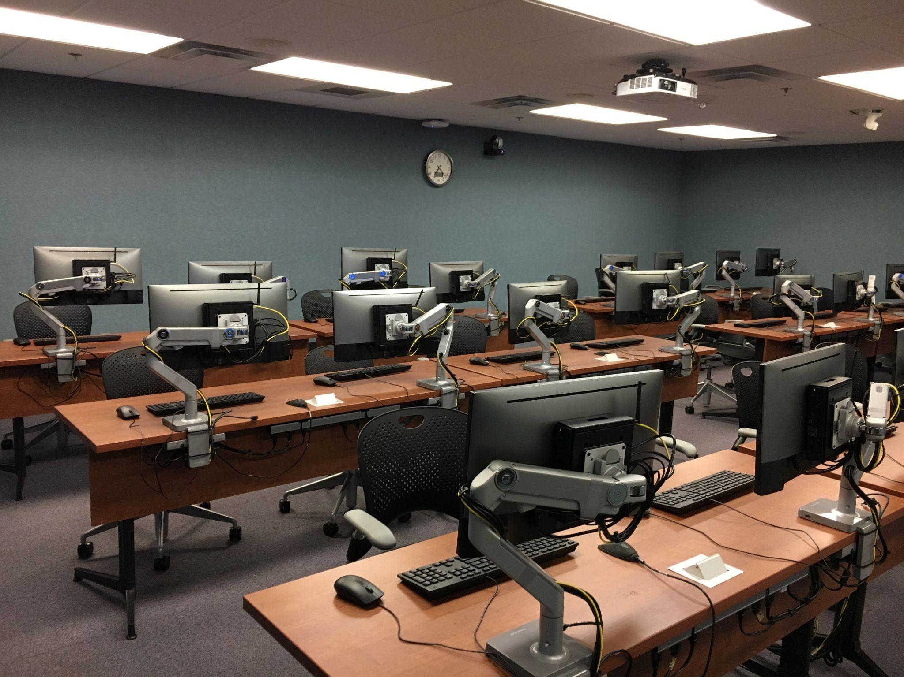
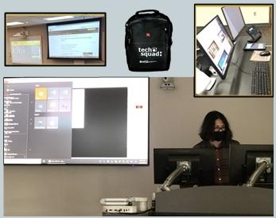
VCU Academic Technologies Teams
Instructional Computing Services
Classroom Audio/Video Support
Computer Hardware & Software Deployment
Audio & Video Technology Management

Slide 3
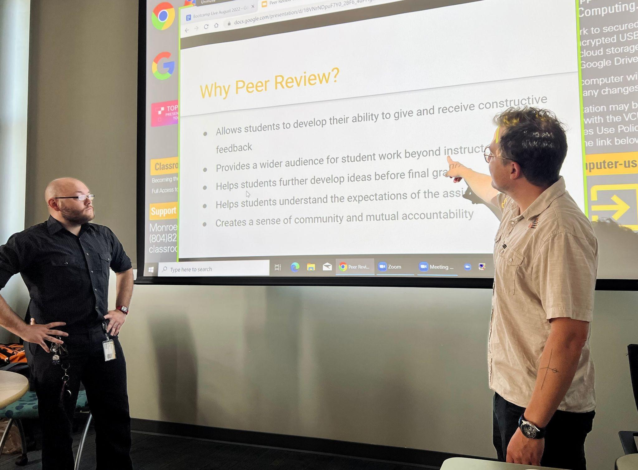
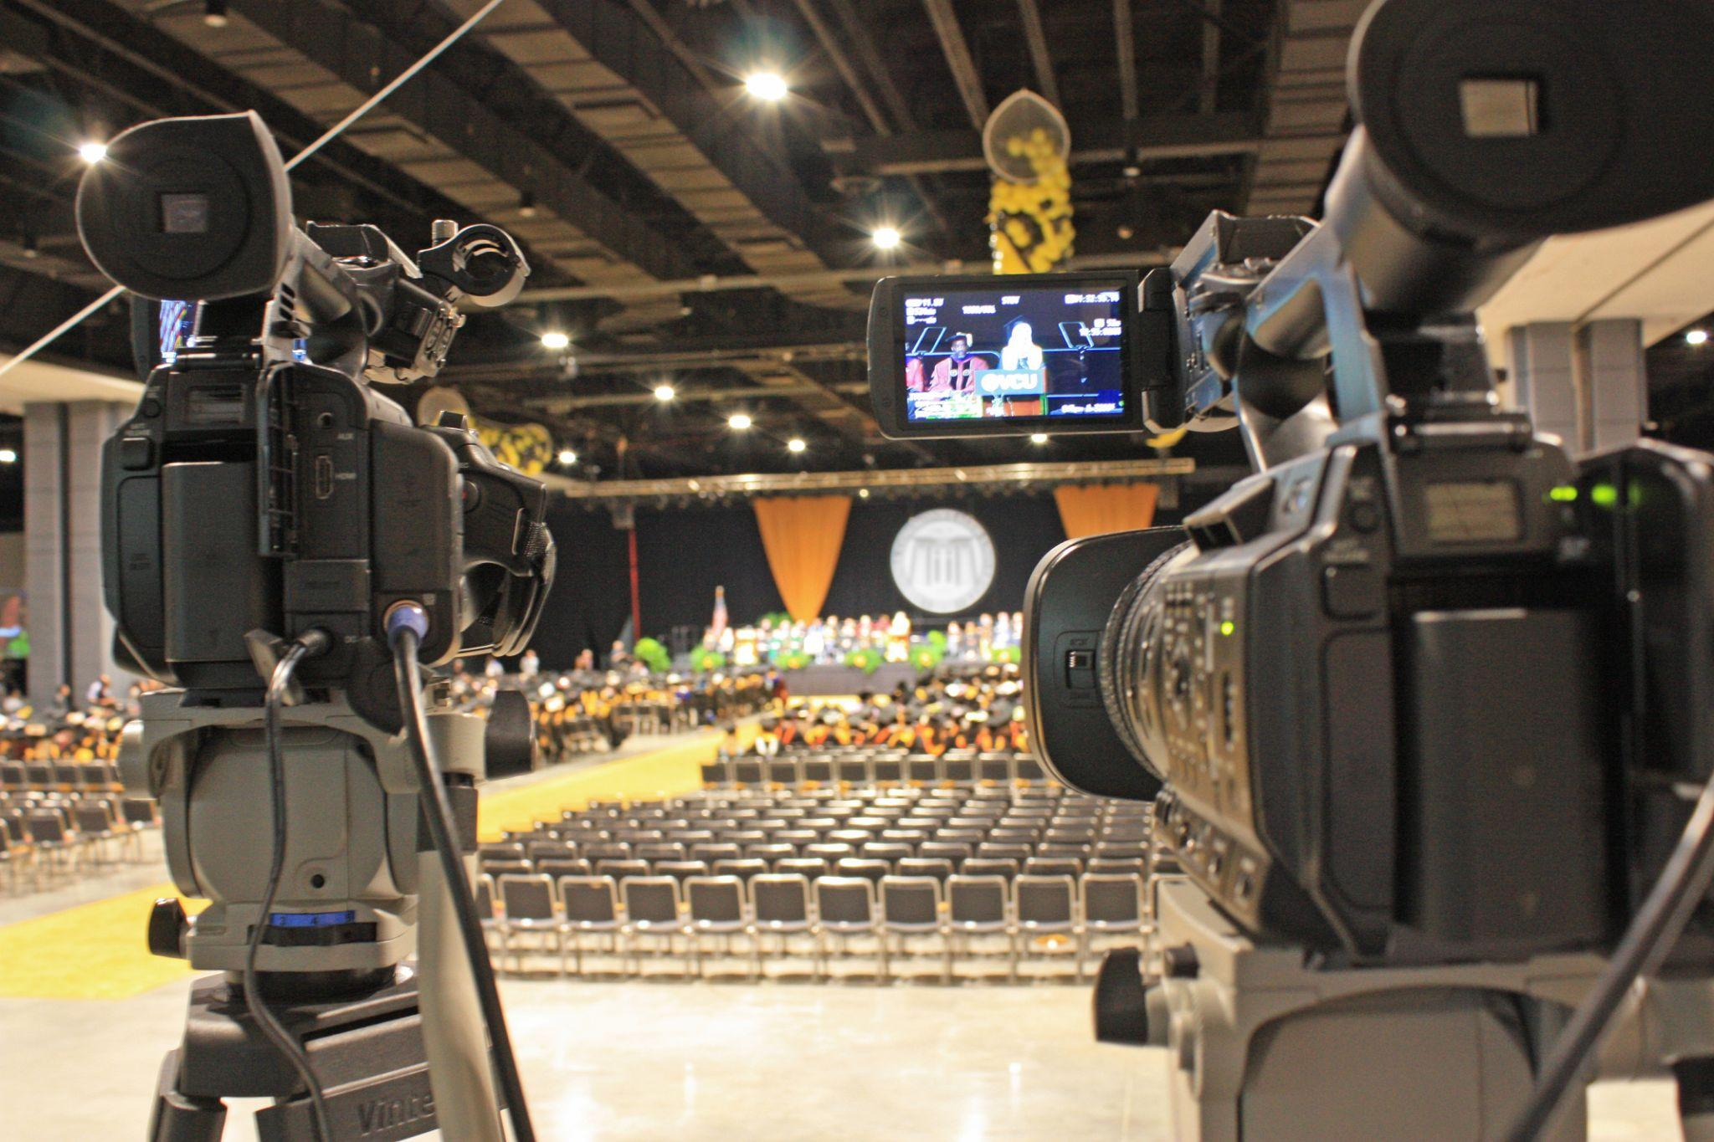
VCU Academic Technologies Teams
Learning Systems
MSS Video Production & Teleconferencing
Web-Based Learning Management
Systems & Tools
Audio/Video Recordings &
Desktop Conferencing Solutions

Slide 4
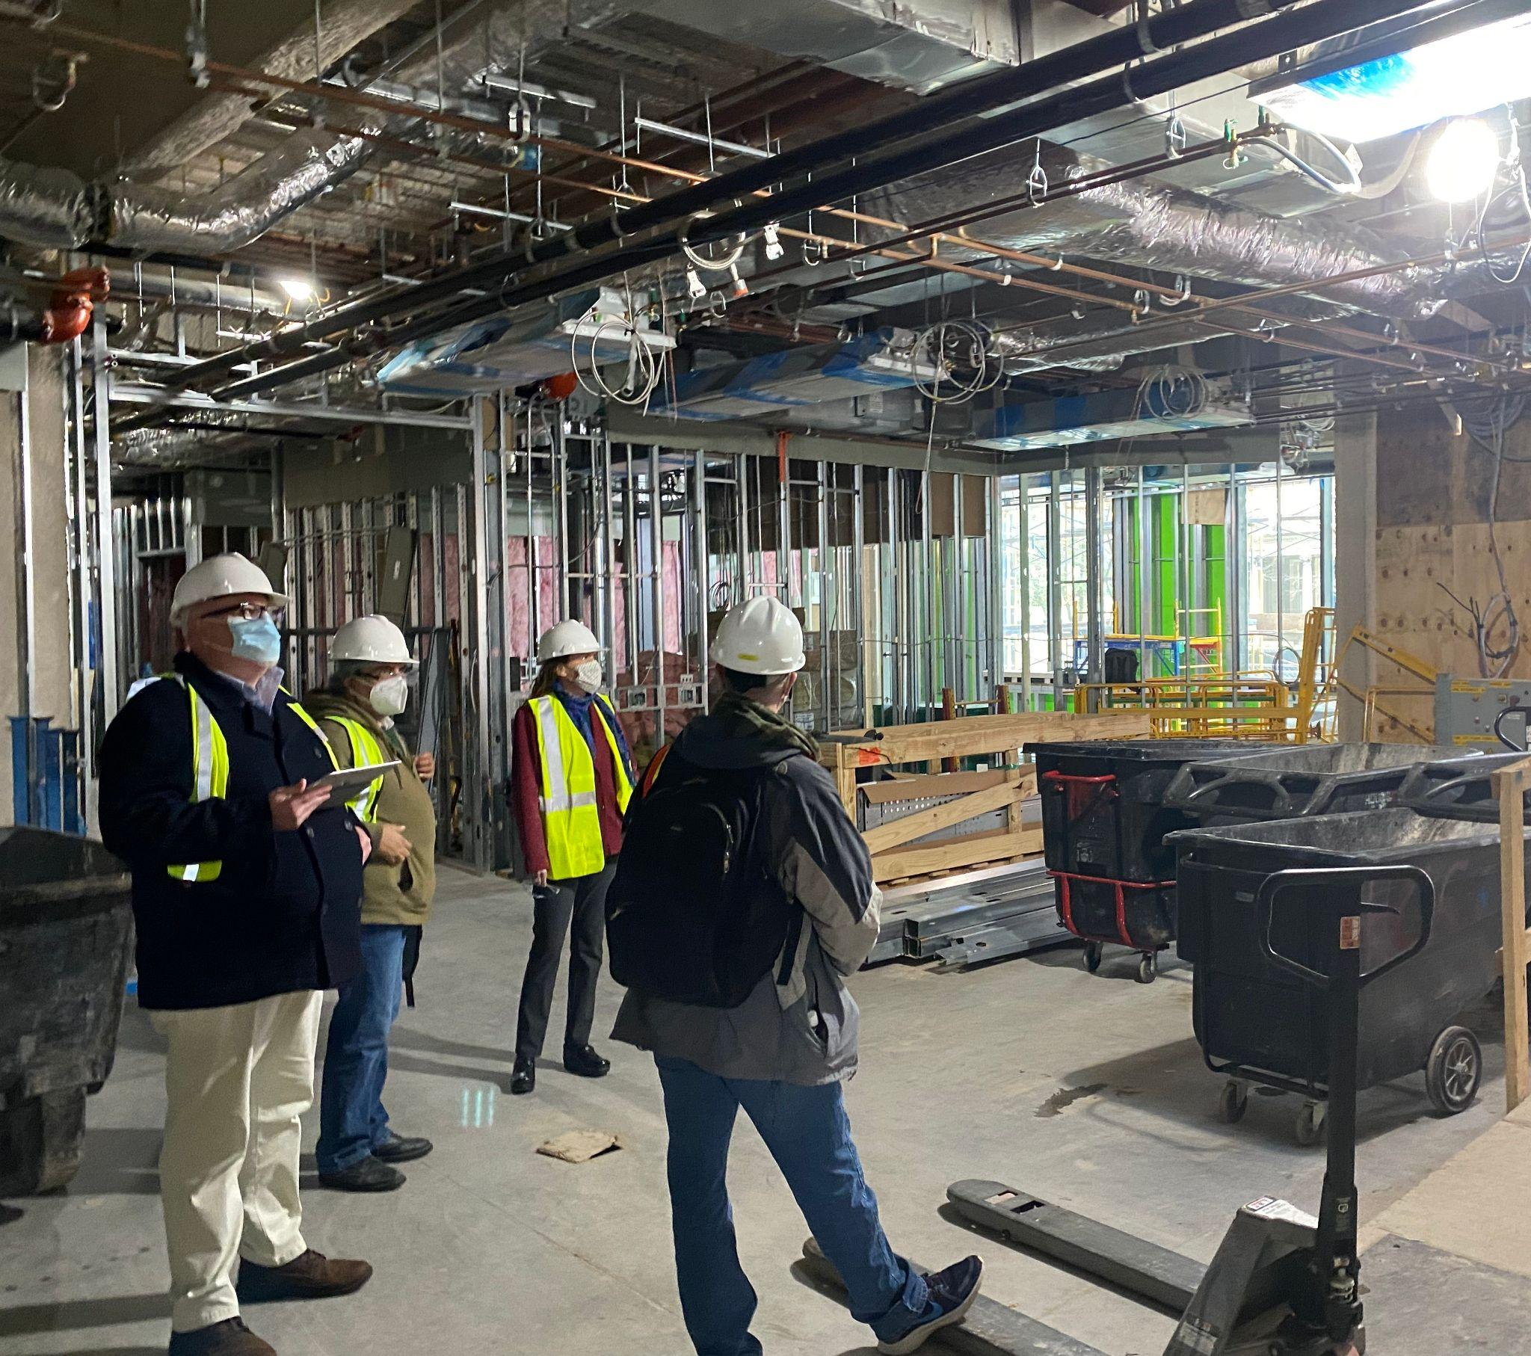
VCU Academic Technologies Teams
MSS Engineering & Design
Developing Technologically Enhanced
Learning Spaces

Slide 5
A Cloud Based Video Management System
CREATE engaging content
CONVERT presentations and lectures to video
DISTRIBUTE to Canvas courses, websites, and more
VIEW from any device, anywhere
go.vcu.edu/kaltura

Slide 6
Assessment Tools for Learning
Respondus
Lockdown Browser
Protects online exam integrity
Locks down the testing environment
Integrates with Canvas
+
Monitor
Automated proctoring with webcams
Launches from any web browser
Integrates with Canvas & publisher systems
go.vcu.edu/respondus

Slide 7
Fill the Social Presence Gap in Online Learning
vt
voicethread
Share images, documents, audio/video and other files.
SHOWCASE
Multi-sensory environment with inclusive, interactive discussions.
COLLABORATE
Create challenging and insightful learning experiences.
EDUCATE
voicethread.com/support
voicethread.com/workshops

Slide 8
Canvas LMS is a robust digital foundation for all aspects of higher-ed learning.
CANVAS
Content Creation and Delivery
Rubrics, modules, calendars, quizzes, syllabi, analytics, discussions, assessments, grades. and more.
Collaborative Tools
Messaging, audio notes, video, and more.
Mobile Apps
Take Canvas anywhere, grade on the go, stay connected to students!
Teaching and Learning
Powered by Canvas LMS
for Higher Education
Login - go.vcu.edu/canvas (use your VCU login credentials)
Support - go.vcu.edu/canvas247support or email: LSRequest@vcu.edu

Slide 9
Zoom Desktop Conferencing Solution for VCU
Available to VCU faculty, staff and students.
Lead or attend virtual meetings from anywhere.
Supports remote instruction and collaboration.
Get your VCU license at vcu.zoom.us
(login with your VCU eID and password)
share audio/video files
share computer content
whiteboard
breakout rooms
chat
polling
quizzes
transcript & captioning
record to the cloud
go.vcu.edu/zoom

Slide 10
Adobe Creative Cloud
go.vcu.edu/adobe/students

Slide 11
Participation & Engagement
Attendance
Polls
Evaluate Comprehension
Quizzes
Grades
Student Responses From Any Device
go.vcu.edu/tophat

Slide 12
Instructional Technologies Hub
Resources for University-approved Technologies
for Course Development, Delivery and Student Assessment
go.vcu.edu/instructionaltechhub
Instructional Technology Toolkit
Training and Support
go.vcu.edu/instructionaltechtoolkit
For Instructors
Classroom Resources
Online Course Resources
Pedagogical Resources
Zoom Resources
Live Workshops
Recorded Workshops
Self-paced Training
Events
Additional Resources
Teaching with Technology
Accessibility
New Semester Quick Guide
Surveys and Feedback

Slide 13
Students
Technologies that Enhance Your Learning Experience at VCU
Adobe Creative Cloud
Creativity apps available to all enrolled students
Canvas
Web-based learning management system
go.vcu.edu/adobe/students
go.vcu.edu/canvas/students
Respondus Lockdown Browser & Monitor
Used to lock down a testing environment in Canvas
Top Hat
Interactive response system for classroom polls, etc.
go.vcu.edu/respondus
go.vcu.edu/tophat
To learn more, visit:
go.vcu.edu/student-tech

Slide 14
Visit our Websites for Information and Support
go.vcu.edu/academictech go.vcu.edu/learningsystems go.vcu.edu/adobe go.vcu.edu/classroom-support go.vcu.edu/student-tech

